Slide 1
Micflix
Sprint: 3
A netflix clone - by Mickey Krekels
Class: RB04

Slide 2
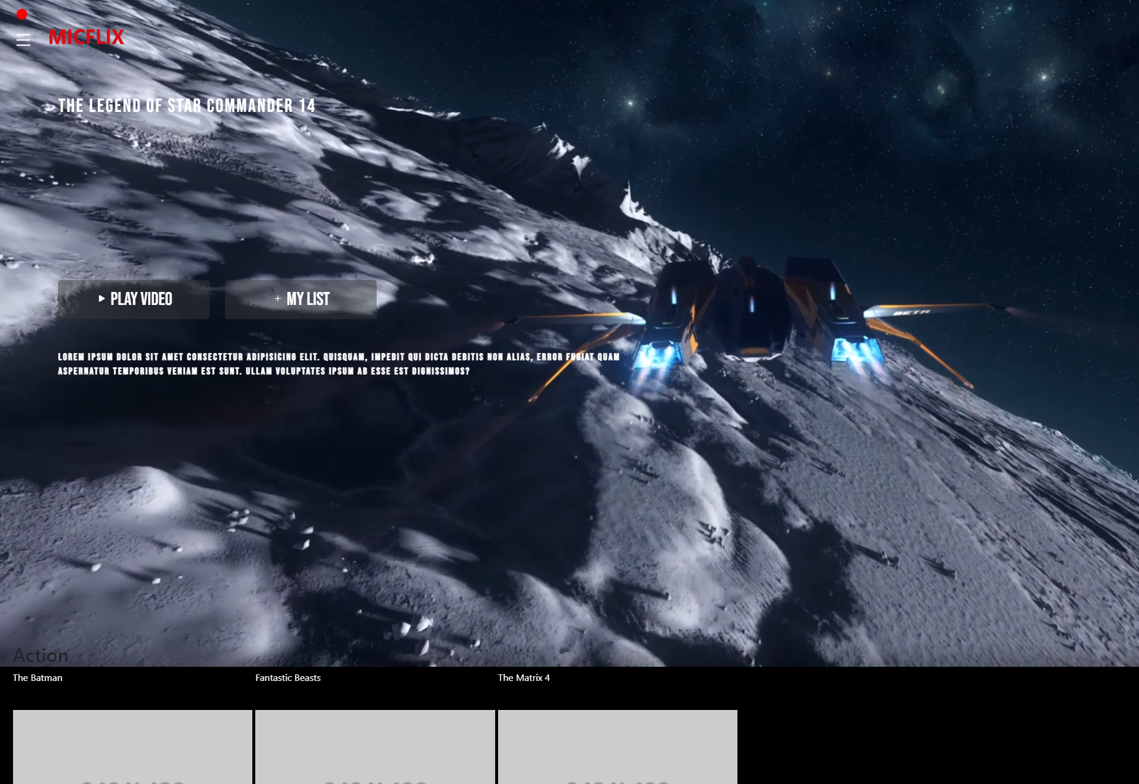
Introduction
Sprint goal
Achievements
Foundation Topics
Enterprise Architecture & Software Platforms
Architecture & Quality
Messaging & Security-by-Design
DevSecOps & Cloud Services
Roadmap
Next steps

Slide 3
Sprint goal
The main goal of sprint 3 was to start working on a local Kubernetes cluster and adding additional features.
The issues/stories created for the sprint were:
Research how to convert docker compose file to a Kubernetes variant
Research how to link databases to services in Kubernetes
Research how to use an Ingress controller
Create a local Kubernetes cluster
Create an owasp analyses
Create an performance analyse analyses
Update the front-end visuals in the style of the Netflix UI

Slide 4
ACHIEVEMENTS
Local Kubernetes cluster
Ingress controller researched
UI front-end updated
Owasp analyse created
Observability & Performance analyse created
Connected the Github Actions to sonarcloud

Slide 5
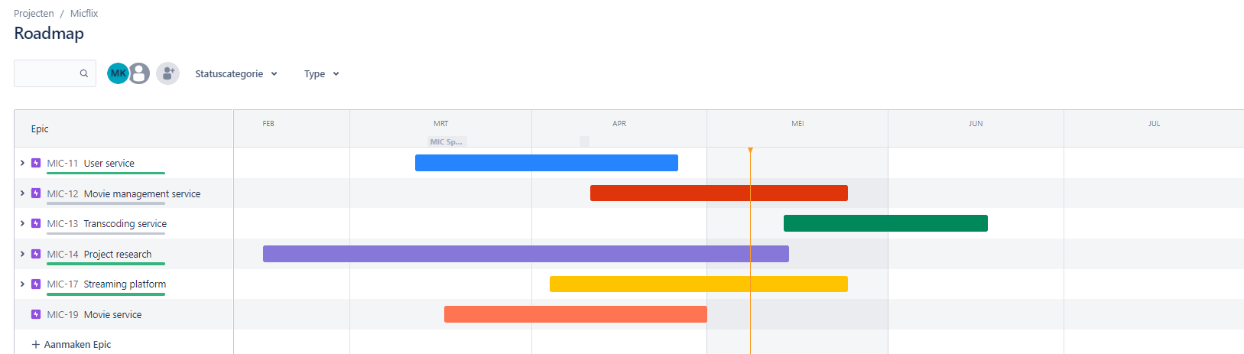
Enterprise Architecture & Software Platforms
Jira
Notes:
Enterprise applications (EA) are applications that are used in an enterprise context and are mainly used to satisfy the information management needs of an organization rather than individual users.

Slide 6
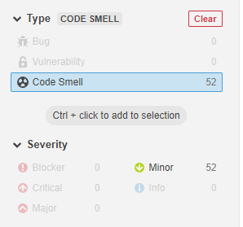
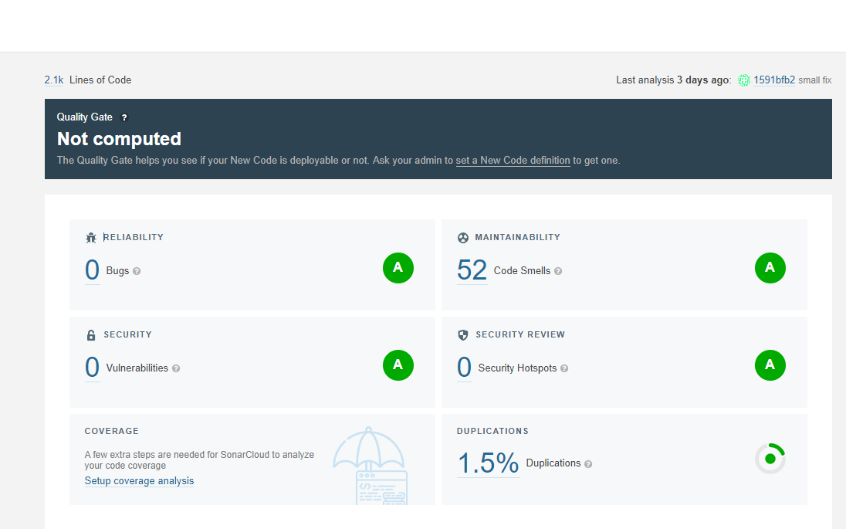
Architecture & Quality
Added SonarCloud to the CI/CD pipeline

Slide 7
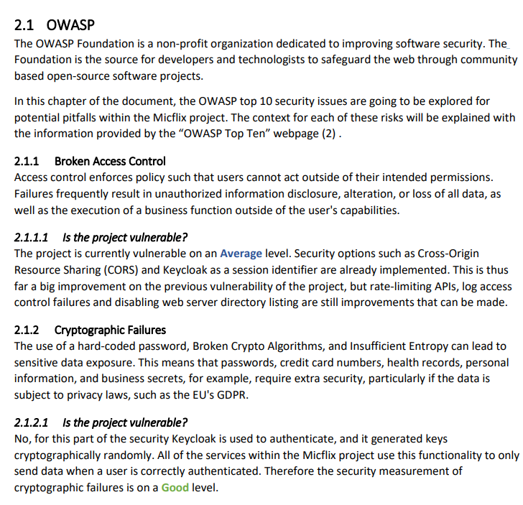
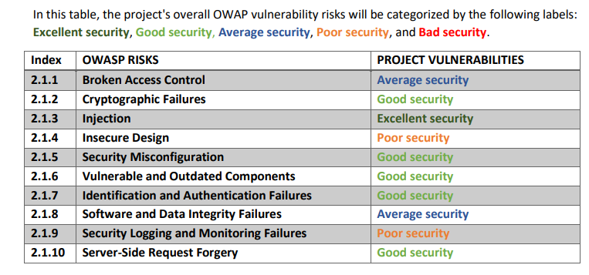
Messaging & Security-by-Design
Added the OWSP Analysis
Added the OWSP Analysis
Added data complexity Analysis

Slide 8
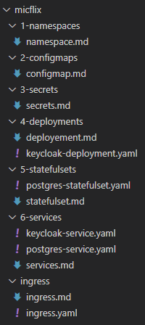
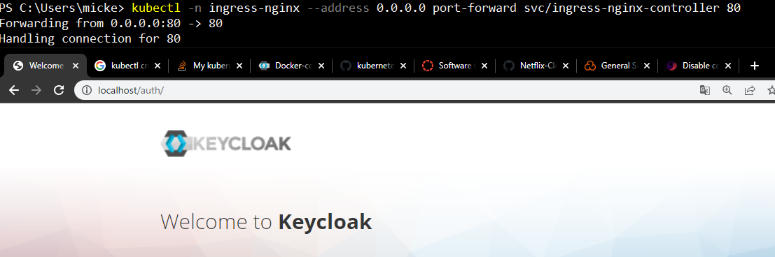
DevSecOps & Cloud Services
Created an kubemanifests locally
Added an Ingress conntroller and services
Added secrets and configmaps
Added statefulsets with data persistence

Slide 9
DEMO ( UI showcase )
[ link ]

Slide 10
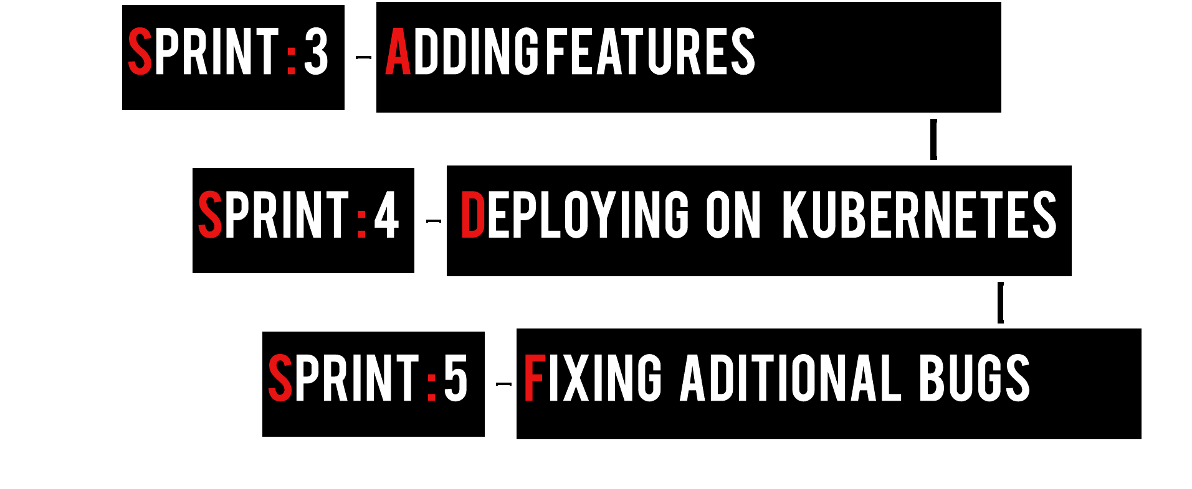
Roadmap

Slide 11
Next steps
Deploying kubernetes to Azure (Or personal server)
Adding Unit to the CI/CD pipeline and Sonarcloud
Verifying the Non-functional
Scalability
Security
Reliability
Maintainability

